Slide 1
Detecting Exoplanets and recovering Parameters
A short recap of my work in week 3

Slide 2
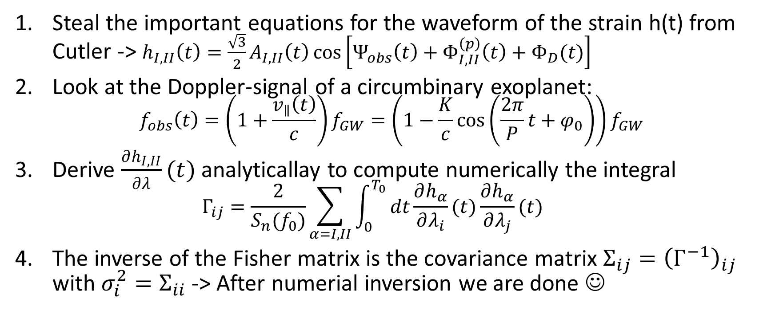
What did Tamanini and Danielski do?
Steal the important equations for the waveform of the strain h(t) from Cutler -> $h_{I,II}\left(t\right)=\frac{\sqrt{3}}{2}A_{I,II}\left(t\right)\cos\left[Ψ_{obs}\left(t\right)+Φ_{I,II}^{\left(p\right)}\left(t\right)+Φ_{D}(t)\right]$
Look at the Doppler-signal of a circumbinary exoplanet: $f_{obs}\left(t\right)=\left(1+\frac{v_{∥}\left(t\right)}{c}\right)f_{GW}=\left(1−\frac{K}{c}\cos\left(\frac{2π}{P}t+φ_{0}\right)\right)f_{GW}$
Derive $\frac{∂h_{I,II}}{∂λ}(t)$ analyticallay to compute numerically the integral $Γ_{ij}=\frac{2}{S_{n}(f_{0})}\sum_{α=I,II}{\int_{0}^{T_{0}}{dt\frac{∂h_{α}}{∂λ_{i}}(t)\frac{∂h_{α}}{∂λ_{j}}(t)}}$
The inverse of the Fisher matrix is the covariance matrix $Σ_{ij}={\left(Γ^{−1}\right)}_{ij}$ with $σ_{i}^{2}=Σ_{ii}$ -> After numerial inversion we are done ☺

Slide 3
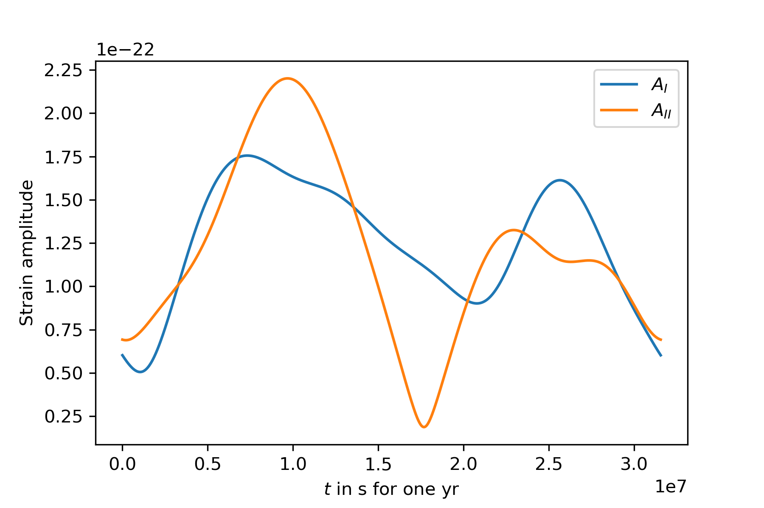
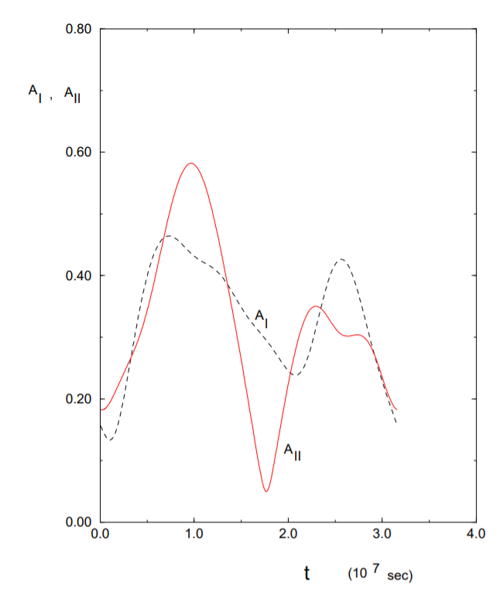
1. Steal from Cutler: Amplitude
The amplitude and pattern function of course depends strongly on the eclptic coordinates of the source – thankfully Tamanini and Danielski used the same example coordinates to place their binary as Cutler

Slide 4
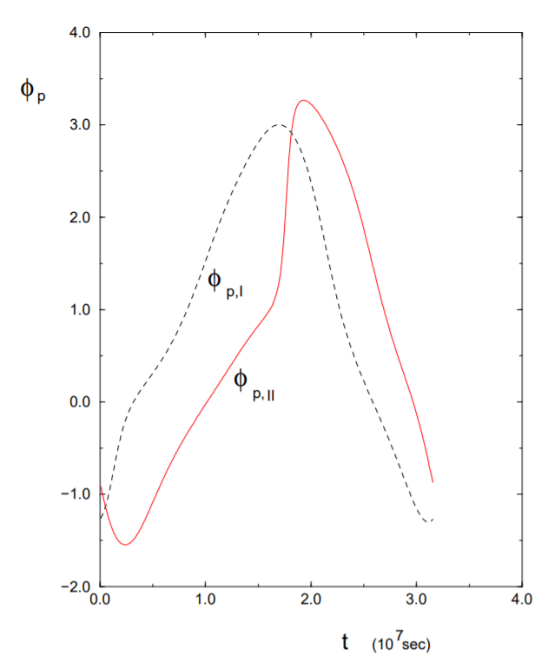
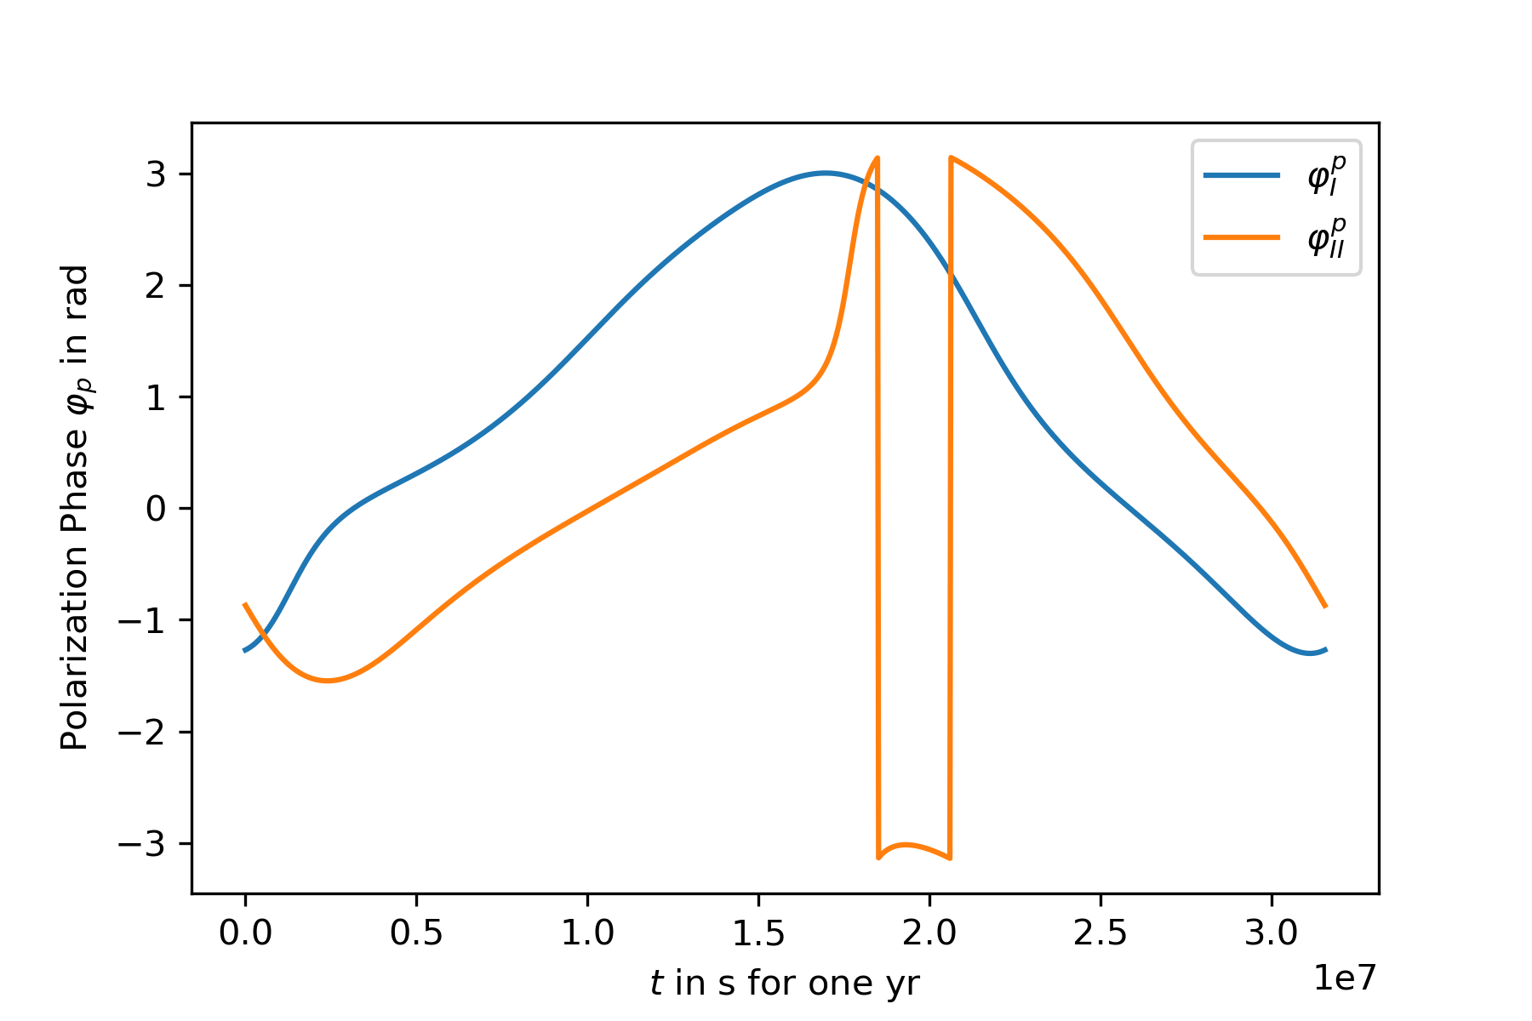
1. Steal from Cutler: Polarization Phase
Note the incontinuity due to 2$π$ modulus

Slide 5
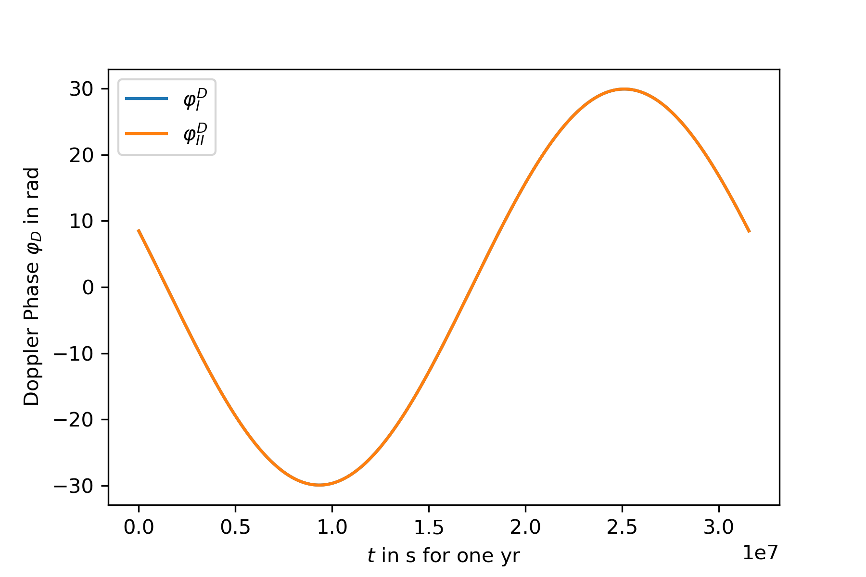
1. Steal from Cutler: Doppler Phase
The amplitude depends on the GW frequency as it should, and it should be the same for the two arms (same barycenter)

Slide 6
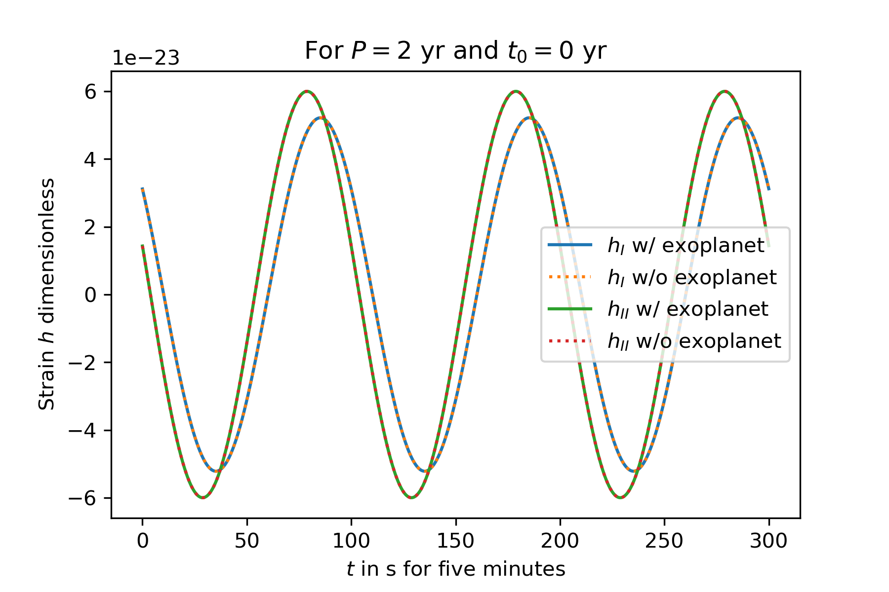
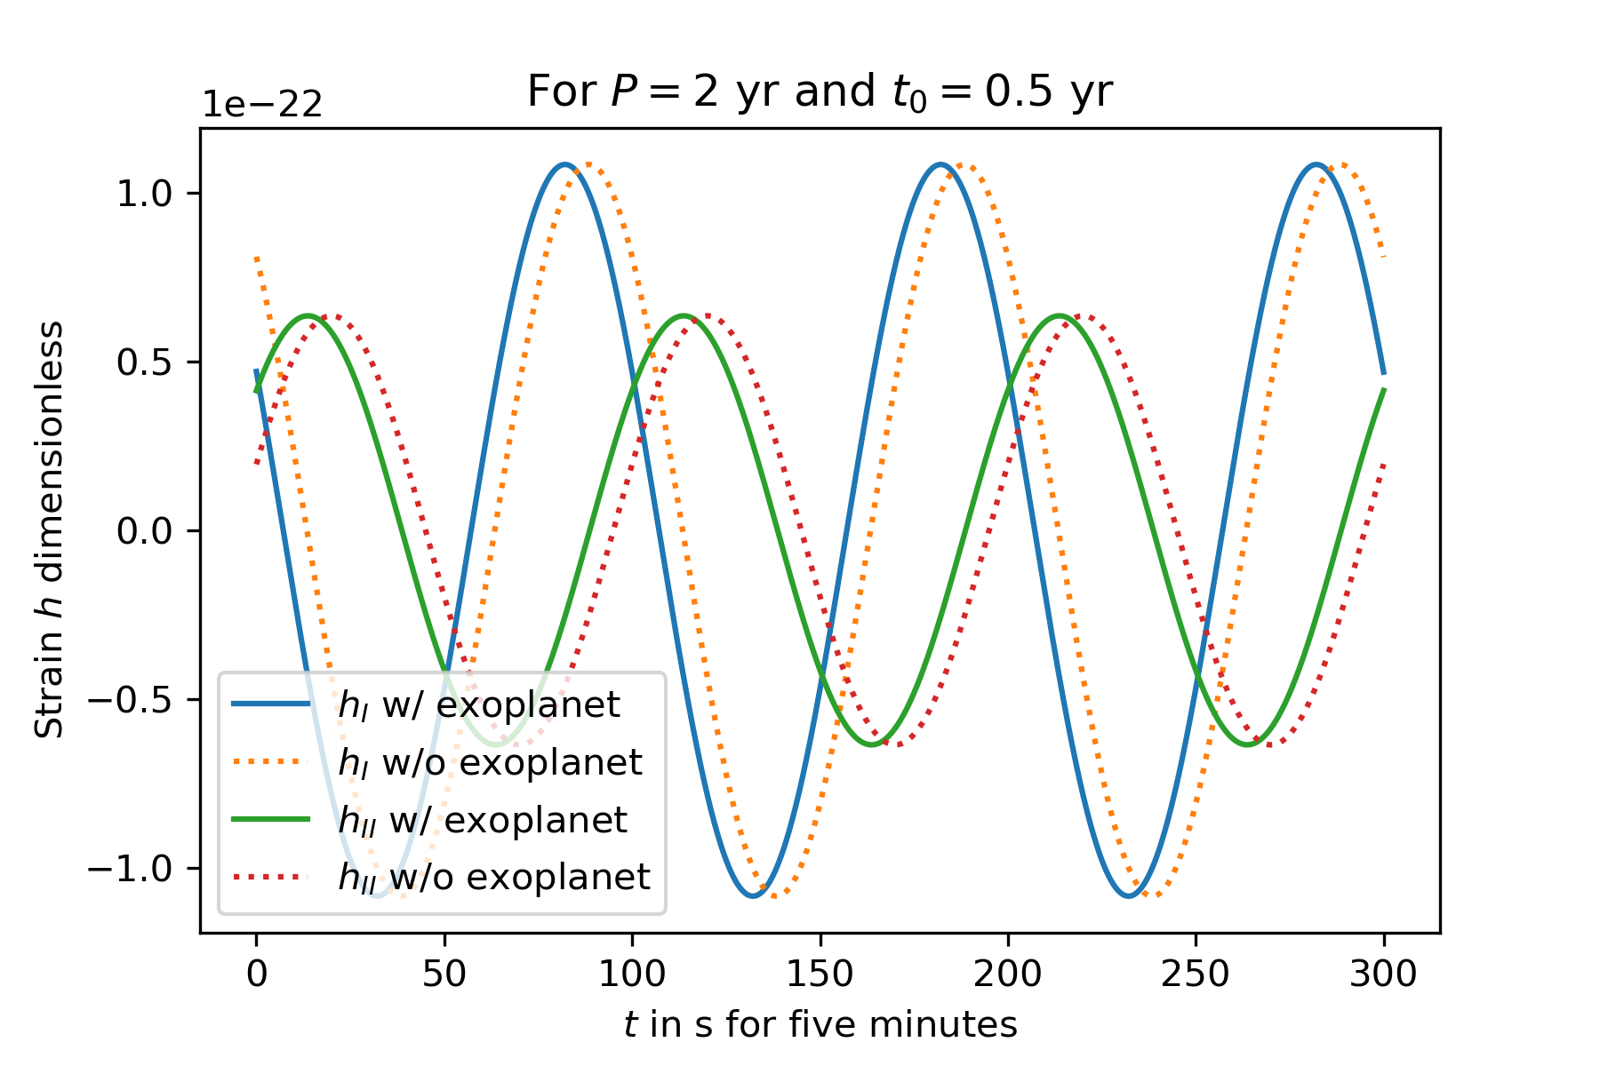
2. Look at the Doppler signal of CBPs
One can see the desyncing due to the presence of an exoplanet quite clearly, here a shift in the waveform due to an explanet of 5 $M_{J}$ over half a year… (different start time of the detector $t_{0}$)

Slide 7
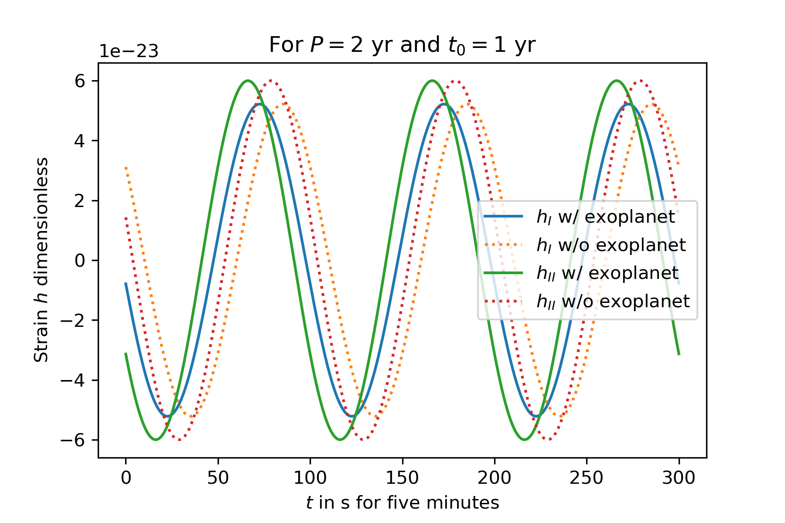

2. Look at the Doppler signal of CBPs
…but after two years we will sync up again (as we should)

Slide 8
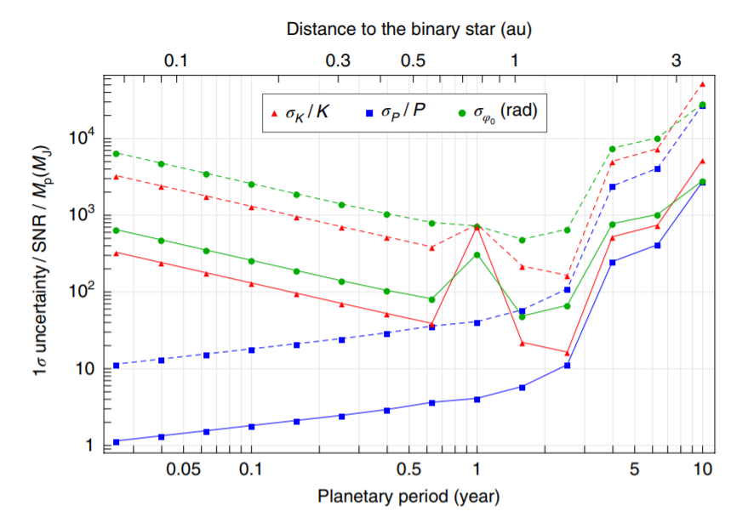
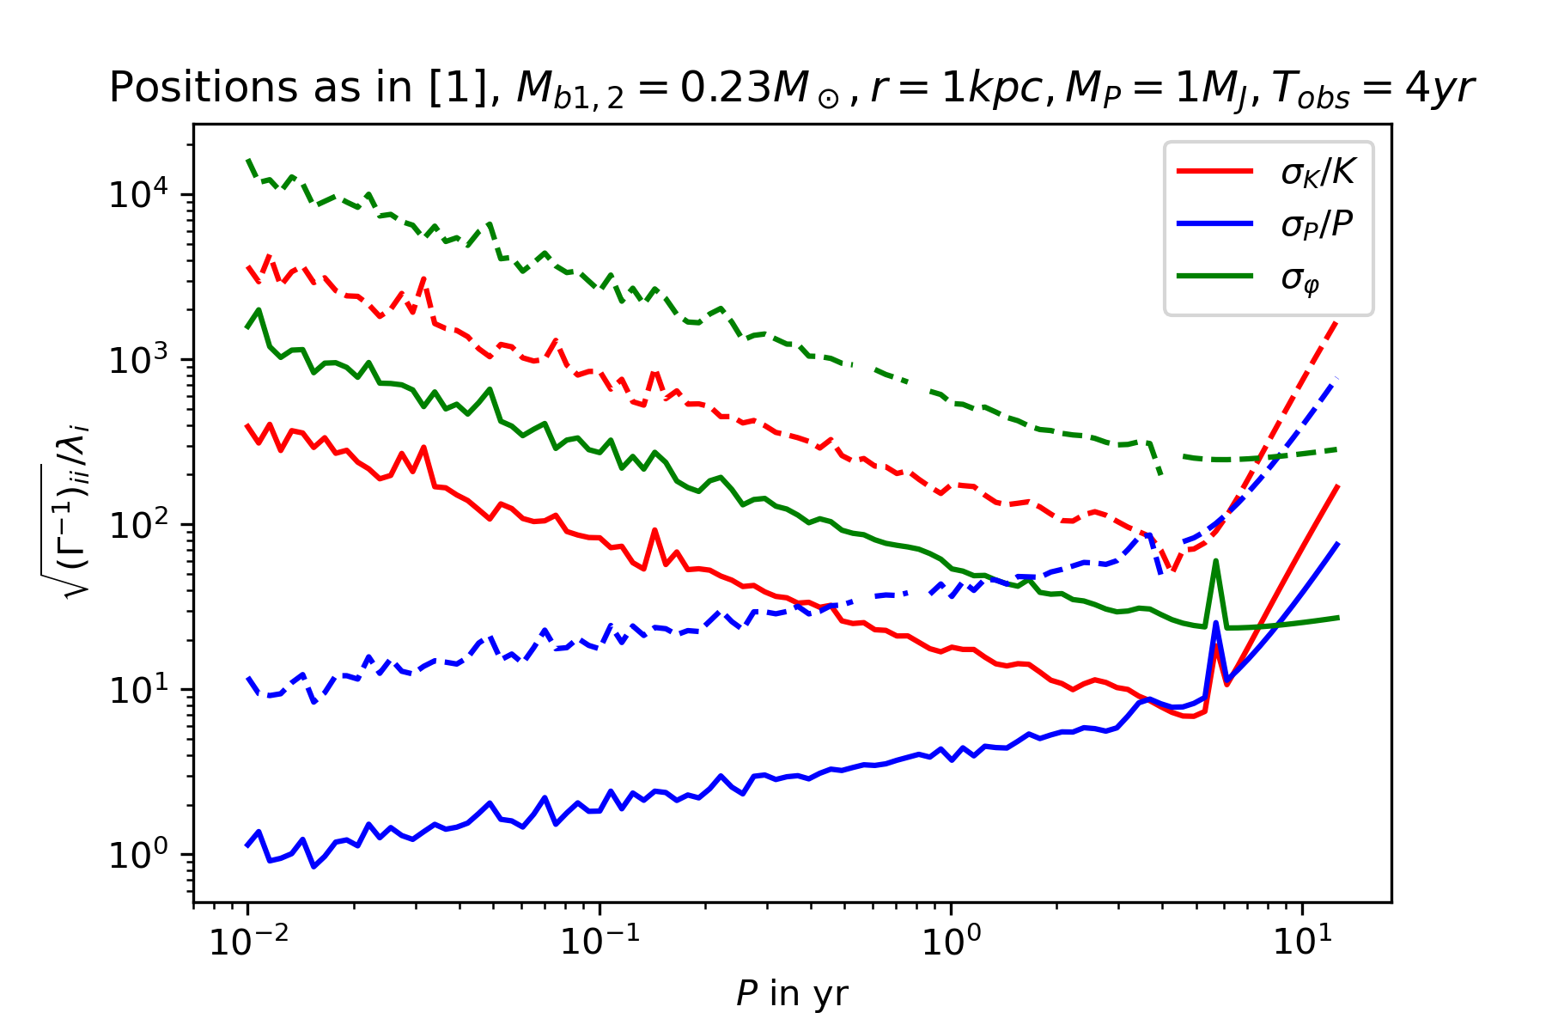
3. Compute the uncertainties
It‘s quite similiar, but: It‘s not the same! Where is the degeneracy at 1 yr?
Note #1: Wigliness probably due to floating point errors in integration + matrix inversion
Note #2: Different amplitude probably due to me using the wrong strain sensitivity, WIP

Slide 9

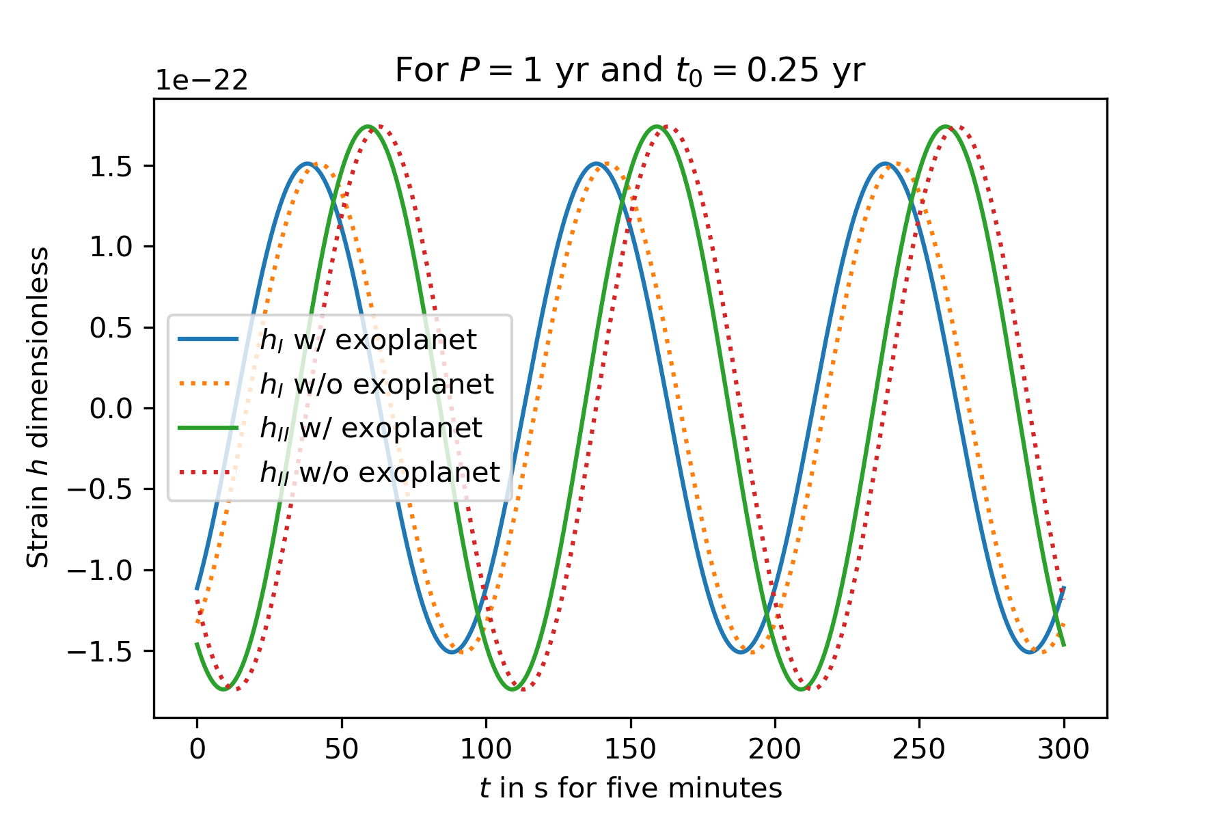
4. Why don‘t I see the degeneracy at P=1 yr?

Slide 10
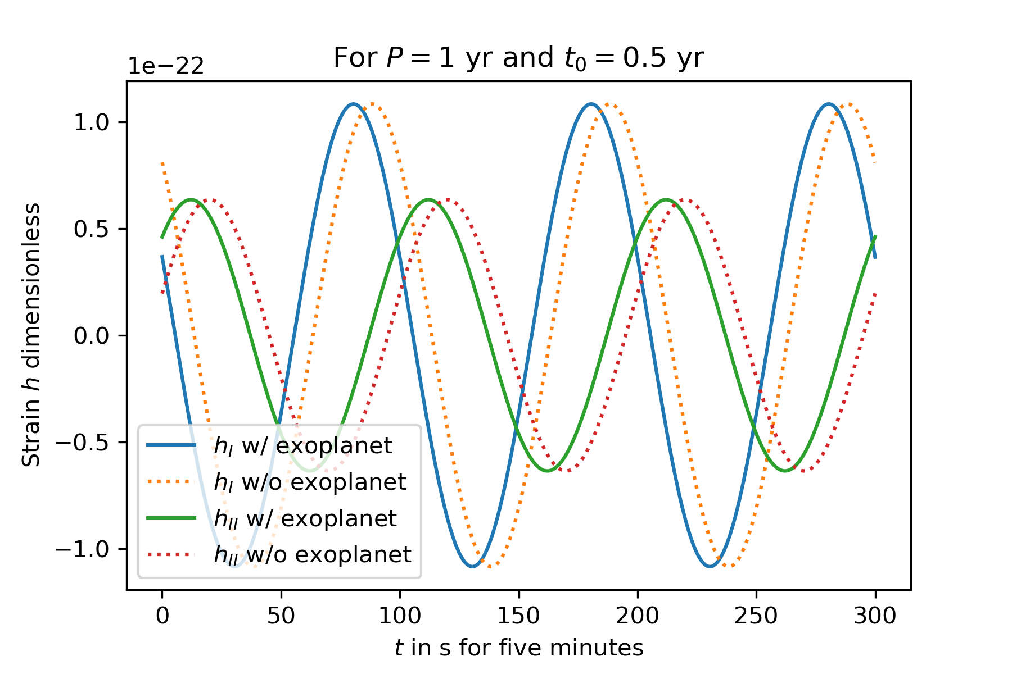
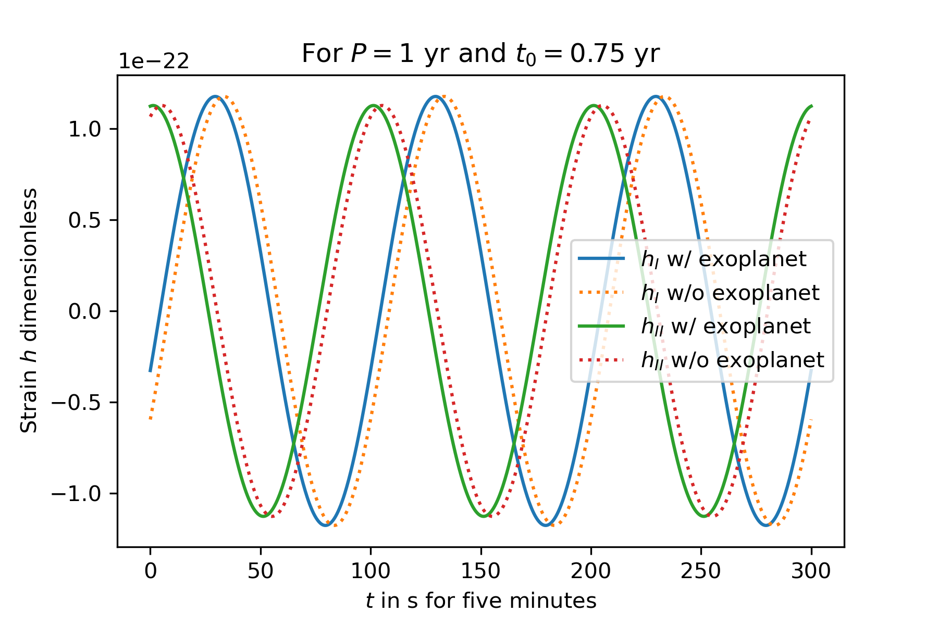
4. Why don‘t I see the degeneracy at P=1 yr?

Slide 11

4. Why don‘t I see the degeneracy at P=1 yr?
I don‘t see exactly, why there should be one: The amplitude of the frequency shift is still given by K and should in principle be read out by a search algorithm independent of the P=1 yr thing
-> I‘m still looking for bugs in my code though

Slide 12
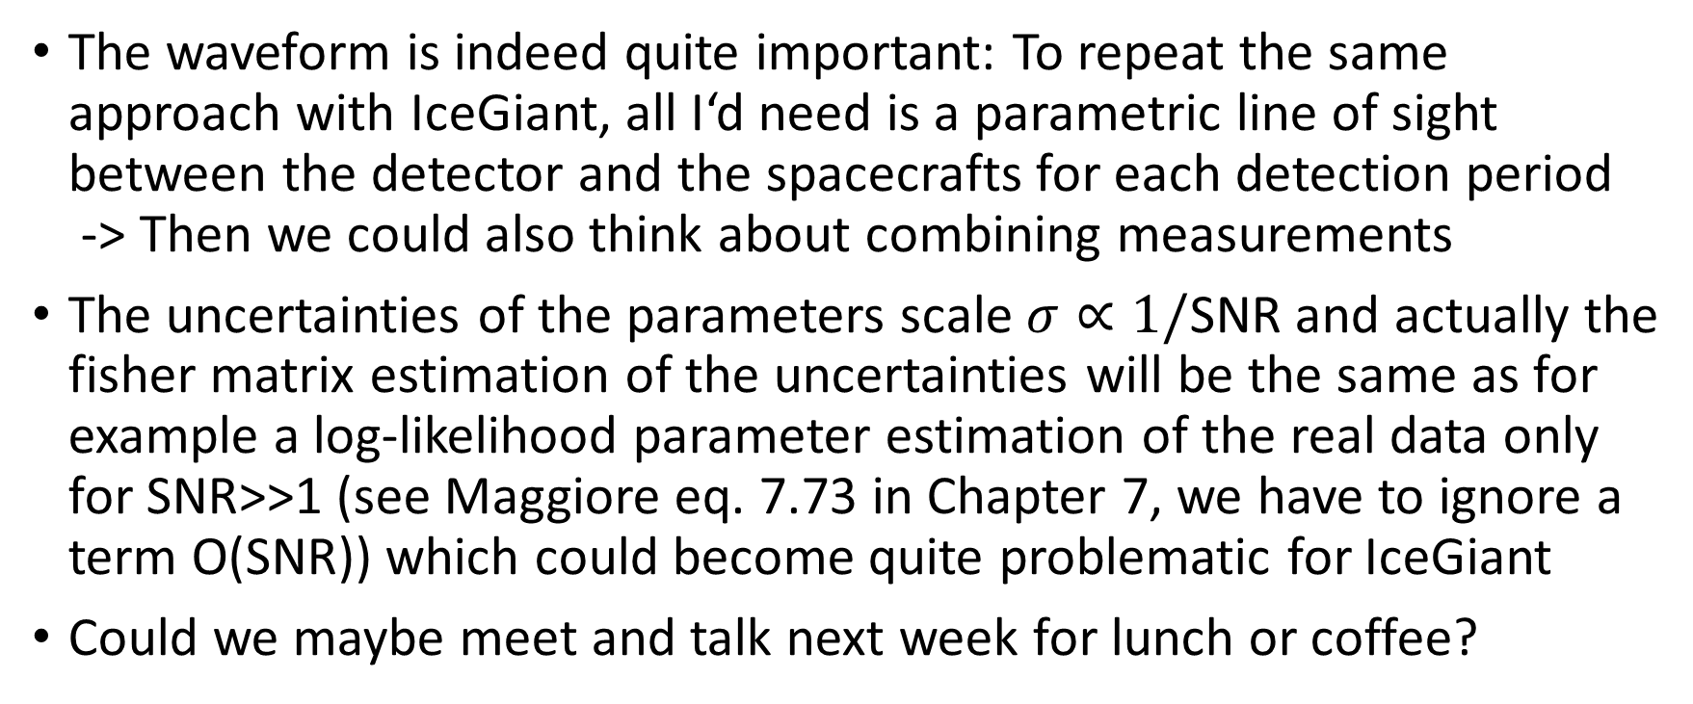
5. New inputs
The waveform is indeed quite important: To repeat the same approach with IceGiant, all I‘d need is a parametric line of sight between the detector and the spacecrafts for each detection period -> Then we could also think about combining measurements
The uncertainties of the parameters scale $σ∝1/$SNR and actually the fisher matrix estimation of the uncertainties will be the same as for example a log-likelihood parameter estimation of the real data only for SNR>>1 (see Maggiore eq. 7.73 in Chapter 7, we have to ignore a term O(SNR)) which could become quite problematic for IceGiant
Could we maybe meet and talk next week for lunch or coffee?

